Slide 1
Unified Modeling Language (UML)
The Unified Modeling Language (UML) is a general-purpose, developmental, modeling language in the field of software engineering that is intended to provide a standard way to visualize the design of a system.
It was developed at Rational Software in 1994–1995, with further development led by them through 1996.
In 1997, UML was adopted as a standard by the Object Management Group (OMG), and has been managed by this organization ever since.
In 2005, UML was also published by the International Organization for Standardization (ISO) as an approved ISO standard.
@ShankaragoudaG

Slide 2
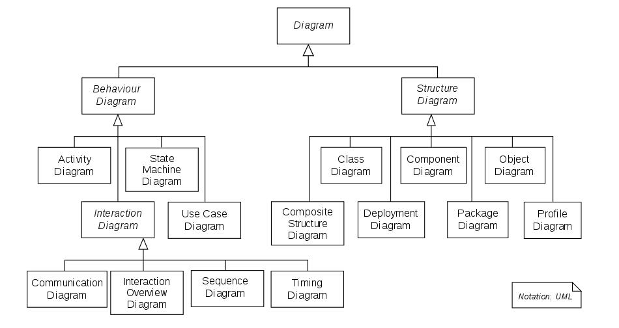
UML Diagram Types

Slide 3
Structure diagram
Structure diagrams represent the static aspects of the system.
It emphasizes the things that must be present in the system being modeled.
Since structure diagrams represent the structure, they are used extensively in documenting the software architecture of software systems.

Slide 4
Behavior diagram
Behavior diagrams represent the dynamic aspect of the system.
It emphasizes what must happen in the system being modeled.
Since behavior diagrams illustrate the behavior of a system, they are used extensively to describe the functionality of software systems.

Slide 5
Useful Resources
https://en.wikipedia.org/wiki/Unified_Modeling_Language
https://creately.com/blog/diagrams/uml-diagram-types-examples/
https://www.javatpoint.com/uml-diagrams
https://www.tutorialspoint.com/uml/uml_standard_diagrams.htm

